Slide 1
EMAIL SPAM DETECTION 98% ACCURACY
Presented by: SAKTHI.K
III year,KVCET
NM ID-au421221243034
Email ID-sakthisanjay68@gmail.com

Slide 2
PROPOSED SYSTEM
Email spam continues to be a significant issue, inundating inboxes and consuming users' time and resources. To mitigate this problem, an advanced email spam detection system with a 98% accuracy rate is proposed. Leveraging machine learning techniques and natural language processing (NLP), the system can effectively identify and filter out spam emails, ensuring that users receive only legitimate correspondence in their inboxes.

Slide 3
PROBLEM STATEMENT
Email spam remains a persistent and widespread issue, plaguing users with unwanted and potentially harmful messages. Despite advancements in email filtering technologies, many users still struggle to effectively manage their inboxes due to the continuous onslaught of spam. Therefore, there is a pressing need for an advanced email spam detection system that can accurately identify and filter out spam emails with a high degree of precision and reliability.
Accuracy.
Adaptability
Scalability

Slide 4
PROPOSED SOLUTION
Developing an advanced email spam detection system with a 98% accuracy rate. Leveraging machine learning techniques, natural language processing (NLP), and robust feature engineering, the system will analyze incoming emails in real-time and accurately classify them as either spam or legitimate. By continuously updating its algorithms and adapting to new spamming tactics, the system will provide users with a reliable and efficient solution for managing their email inboxes. Additionally, the system will prioritize scalability and user experience, ensuring seamless integration with existing email platforms and delivering a smooth user experience.

Slide 5
SYSTEM APPROACH
System Requirements:
Hardware: Processing Power: The system will require a computer or server with sufficient processing power to handle the computational requirements of training and running machine learning models. This could range from a standard desktop computer to a cloud-based server depending on the scale of the system. Memory (RAM): Adequate RAM is essential for loading and processing large datasets efficiently during model training and inference. Storage: Sufficient storage space is needed to store the dataset, trained models, and any additional resources required by the system. Networking: A stable internet connection is necessary for accessing email data, deploying the system, and receiving updates.
Software:
Programming Languages: Python: Widely used for machine learning, data preprocessing, and system development. R: Another option for statistical analysis and machine learning tasks. Machine Learning Libraries: Scikit-learn: For implementing machine learning algorithms and model evaluation. TensorFlow or PyTorch: For building and training deep learning models if needed.

Slide 6
Natural Language Processing (NLP) Libraries: NLTK (Natural Language Toolkit): For text preprocessing, tokenization, and other NLP tasks. SpaCy: Another powerful library for NLP tasks such as named entity recognition and part-of-speech tagging. Data Processing and Analysis: Pandas: For data manipulation and analysis. NumPy: For numerical computations and array operations. Web Development Flask or Django: For building web-based user interfaces or APIs to interact with the email spam detection system. Email Protocols and Libraries: IMAP or POP3: Protocols for accessing and retrieving emails from mail servers. Libraries such as imaplib or poplib in Python for interacting with email servers programmatically. Development and Deployment Tools: Integrated Development Environment (IDE): Visual Studio Code, PyCharm, or Jupyter Notebook for writing and testing code. Version Control: Git and platforms like GitHub or GitLab for version control and collaboration.

Slide 7
ALGORITHM AND DEPLOYMENT
Data exploration:
Data exploration is a crucial step in understanding the characteristics of the dataset and gaining insights that can inform subsequent stages of model development in the email spam detection system.
Load the Dataset.
Inspect the Data.
Data Cleaning.
Exploratory Data Analysis (EDA).
Feature Engineering.
Correlation Analysis.
Problem formulation:The problem at hand is to develop an efficient email spam detection system capable of accurately distinguishing between spam and legitimate emails with a high degree of precision. The overarching goal is to provide users with a reliable mechanism for filtering out unwanted emails and ensuring that important messages are not mistakenly classified as spam.

Slide 8
Algorithm selection: Naive Bayes: Naive Bayes classifiers are simple yet effective for text classification tasks. They are computationally efficient and work well with high-dimensional data. Support Vector Machines (SVM): SVMs are powerful classifiers known for their ability to handle high-dimensional data and nonlinear decision boundaries. Random Forest: Random Forest is an ensemble learning method that combines multiple decision trees to improve performance and robustness. It is less prone to overfitting compared to individual decision trees and can handle noisy data well. Gradient Boosting Machines (GBM): GBM is another ensemble learning technique that builds multiple weak learners sequentially, with each one correcting the errors of its predecessors. Deep Learning Models: Deep learning models, such as Convolutional Neural Networks (CNNs) or Recurrent Neural Networks (RNNs), can be powerful for text classification tasks. Ensemble Methods: Ensemble methods combine multiple base classifiers to improve overall performance and robustness. Hybrid Approaches: Hybrid approaches combine multiple algorithms or techniques to leverage their respective strengths.

Slide 9
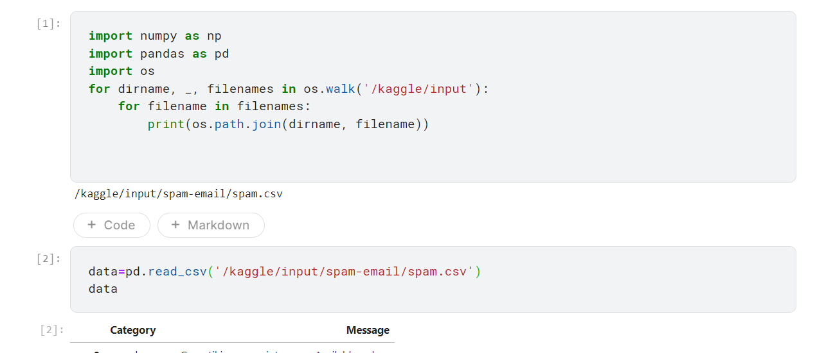
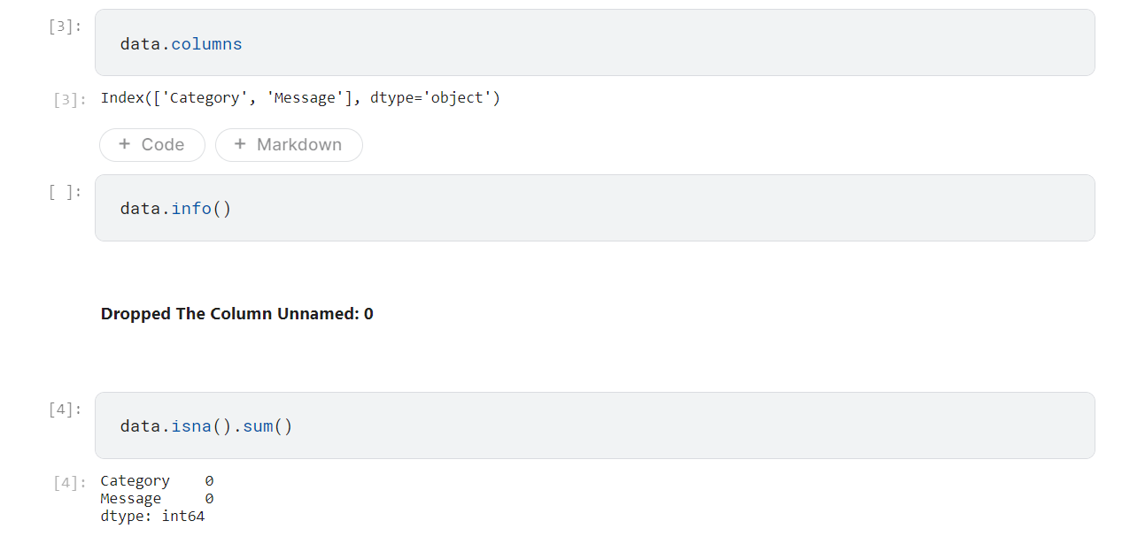
TRAINING AND PROCESS
import libraries:

Slide 10
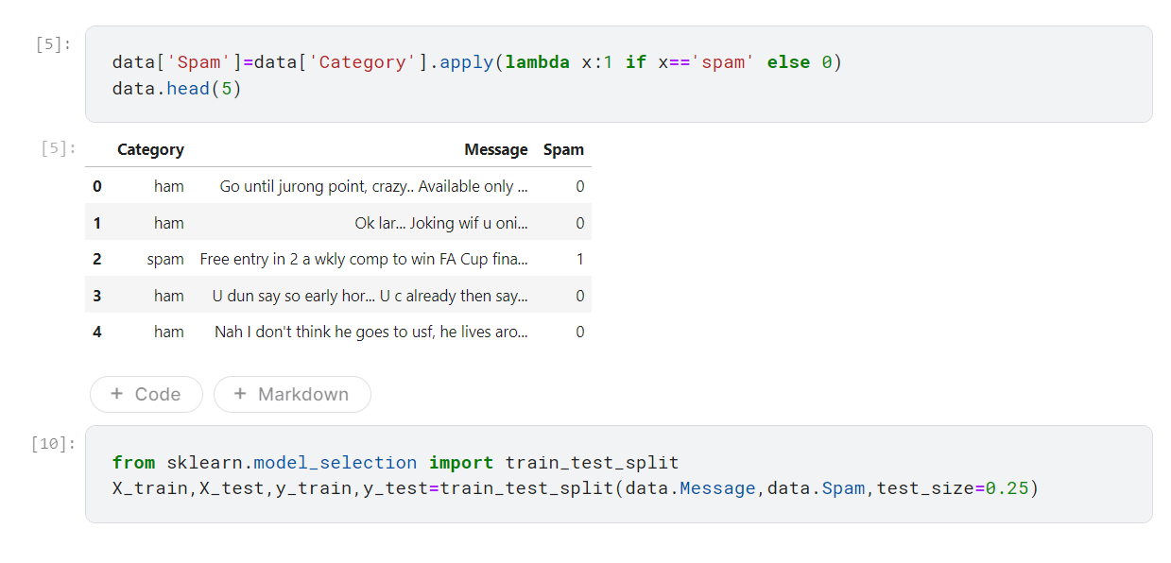
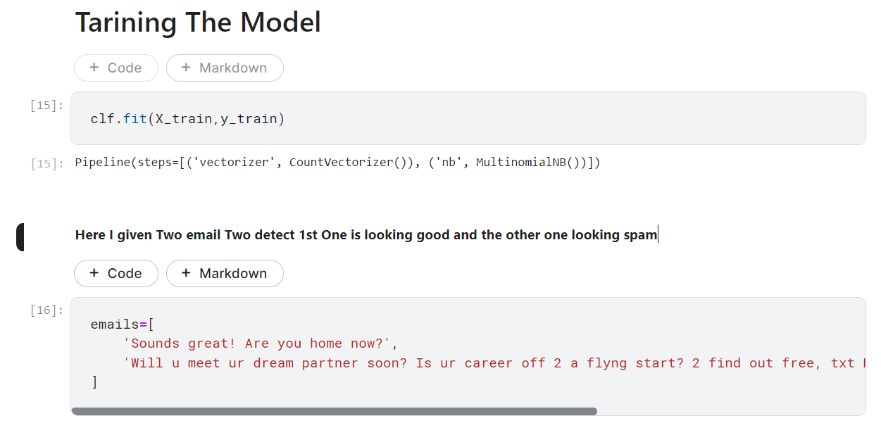
DATA PRE-PROCESSING

Slide 11
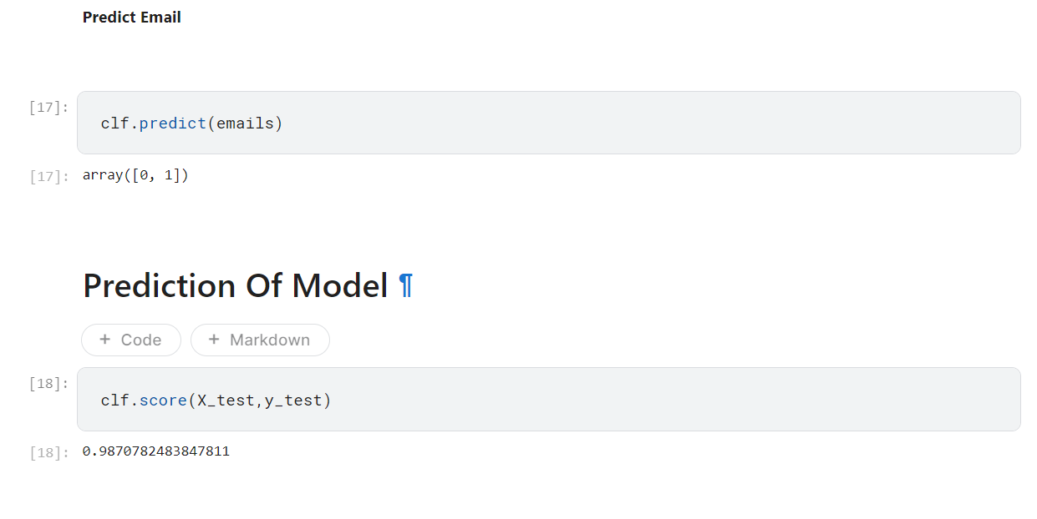
RESULT

Slide 12
CONCLUSION
In conclusion, the development of an email spam detection system is a multifaceted task that requires careful consideration of various factors, including algorithm selection, data preprocessing, feature engineering, and model evaluation. By following a systematic approach and leveraging appropriate tools and techniques, an effective spam detection system can be developed to improve user productivity and security.

Slide 13
FUTURE SCOPE
Enhanced Accuracy: Continuously improving the accuracy of the spam detection system through ongoing refinement of algorithms, feature engineering techniques, and model optimization. Incorporating advanced machine learning algorithms or exploring ensemble methods could lead to further accuracy gains.
Adaptability to Emerging Threats: As spamming techniques evolve, the system should be adaptable to detect and counter new spamming tactics effectively. This requires regular updates and enhancements to the algorithm based on ongoing monitoring of spam trends and user feedback.
Real-Time Feedback Loop: Implementing a real-time feedback loop that allows users to report false positives and false negatives directly within the email client. This feedback can be used to improve the accuracy of the system and refine its spam detection capabilities over time.
Multimodal Analysis: Integrating additional modalities such as images or attachments into the spam detection process to enhance its capabilities. This could involve using image processing techniques to analyze attached images for spam-related content or employing natural language processing techniques to analyze text within attachments.
Personalization and Customization: Providing users with the ability to customize and personalize their spam detection preferences based on individual preferences and usage patterns. This could include fine-tuning spam filters, creating custom whitelists or blacklists, and adjusting sensitivity levels to suit specific needs.

Slide 14
REFERENCES
Cormack, G. V., & Lynam, T. R. (2014). Spam Detection: An Overview. Foundations and Trends in Information Retrieval, 7(4-5), 265–364. [DOI: 10.1561/1500000039]
Androutsopoulos, I., Koutsias, J., Chandrinos, K. V., Paliouras, G., & Spyropoulos, C. D. (2000). An Evaluation of Naive Bayesian Anti-Spam Filtering. In Proceedings of the Workshop on Machine Learning in the New Information Age (pp. 9–17).
Sahami, M., Dumais, S., Heckerman, D., & Horvitz, E. (1998). A Bayesian Approach to Filtering Junk E-Mail. In Proceedings of the AAAI Workshop on Learning for Text Categorization (pp. 98–105).
Forman, G. (2004). An Extensive Empirical Study of Feature Selection Metrics for Text Classification. Journal of Machine Learning Research, 3, 1289–1305.
Pedregosa, F., Varoquaux, G., Gramfort, A., Michel, V., Thirion, B., Grisel, O., Blondel, M., Prettenhofer, P., Weiss, R., Dubourg, V., Vanderplas, J., Passos, A., Cournapeau, D., Brucher, M., Perrot, M., & Duchesnay, É. (2011). Scikit-learn: Machine Learning in Python. Journal of Machine Learning Research, 12, 2825–2830.
Chawla, N. V., Bowyer, K. W., Hall, L. O., & Kegelmeyer, W. P. (2002). SMOTE: Synthetic Minority Over-sampling Technique. Journal of Artificial Intelligence Research, 16, 321–357.
Manning, C. D., Raghavan, P., & Schütze, H. (2008). Introduction to Information Retrieval. Cambridge University Press.
Bishop, C. M. (2006). Pattern Recognition and Machine Learning. Springer.
Hastie, T., Tibshirani, R., & Friedman, J. (2009). The Elements of Statistical Learning: Data Mining, Inference, and Prediction. Springer.
Goodfellow, I., Bengio, Y., & Courville, A. (2016). Deep Learning. MIT Press.

